Slide 1
Lecture 4: Cross Validation, Jackknife, bootstrap

Slide 2
Model selection
Overfitting
Simple model,
A few parameters
OK
Complex model,
Many parameters

Slide 3
What is a good model
Y = f(X) + ε
Simple model,
A few parameters
OK
Complex model
Many parameters
minimum
prediction error

Slide 4
Model selection
WHEN THE DATA SET IS BIG ENOUGH
Divide into training, validation and test
Recommended proportions: 1/3, 1/3, 1/3 or 60%,20%,20%
Alternative- obtain datasets by sampling from the original set
Training
Validation
Test

Slide 5
Model selection process
Given training, validation and test sets and models to choose
M1(?,?)
M2(?,?,?)
M3(?,?,?,?,?)
Training
Validation
Test

Slide 6
Model selection process
Training set is used to fit models
M1(a1,b1)
M2(a2,b2,c2)
M3(a3,b3,c3,d3,e3)
Training
Validation
Test

Slide 7
Model selection process
Validation set is used to select the best model
Best!
M1(a1,b1)
M2(a2,b2,c2)
M3(a3,b3,c3,d3,e3)
Training
Validation
Test

Slide 8
Model selection process
Test set is used to get an unbiased estimate of the error function
M2(a2,b2,c2)
Träning
Validering
Test
Generaliseringsfel

Slide 9
Cross-Validation
What to do when the data set is not enough big?
Idea: estimate prediction error at one or several points by fitting the model to the remaining data

Slide 10
Cross-Validation
K-fold cross-validation (rough scheme, picture follows):
Divide data-set in K roughy equal-sized subsets
Remove subset #i and fit the model using remaining data.
Predict the function values for subset #i using constructed model.
Repeat steps 2-3 for different i
CV= squared difference between observed values and predicted values (another function is possible)

Slide 11
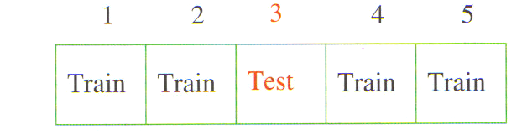

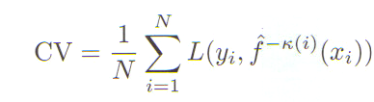
Cross-Validation
Note: if K=N then method is leave-one-out cross-validation.
K-fold cross-validation:

Slide 12

Cross-Validation
How to use CV score for model selection?
Having model depending on tuning (complexity) parameter, choose the one with smallest CV:

Slide 13
Cross-Validation
Issues
Limitations: model should be globally defined
How to define best K?

Slide 14
Jackknife methods
Idea: similar to CV, but used in statistical inference
Bias estimation
Variance estimation
”Jackknife methods make use of systematic partitions of a dataset to estimate properties of an estimator computed from the full sample”
Suppose, we are given a random sample Y=(Y₁,…,Y_{n}) and some estimator T(Y)

Slide 15




Jackknife methods
First-order jackknife
Obtain Y_{(-j)} by dropping group of observations j from Y
For each j, compute T_{(-j)} =T(Y_{(-j)} )
Compute pseudovalues and J(T), called jackknifed T:
Equivalently,

Slide 16


Jaccknife variance estimate
We can use T_{(-j)} or pseudovalues as estimates of T for different samples (both give equivalent expression).
Variance becomes
Sometimes, one takes
!The variance is often overestimated

Slide 17

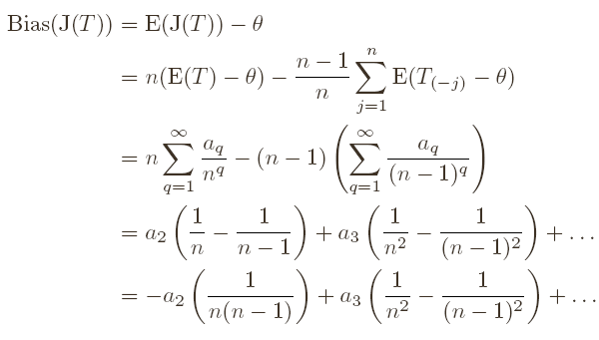
Jackknife bias correction
First-order jackknife
The bias reduced to order n⁻¹ (we take r=n)

Slide 18


Jack-knife estimation of bias
We see that
Hence, bias is

Slide 19


Higher-order jackknife
The order of the bias can be further reduced
Second-order jackknife
Higer order jackkifes –combining jackknides of lower orders:

Slide 20
Higher-order jackknife
Comments
High order jack-knifes reduce the bias but they increase the variance
Delete-1 jackknife is not always appropriate (median). Use delete-k

Slide 21
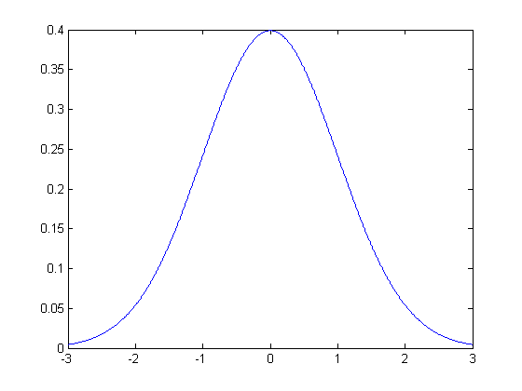
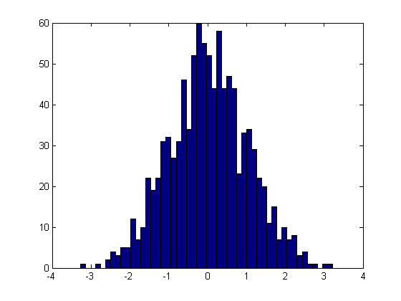
Bootstrap
Unknown: Distribution of X (CDF P)
We have: Data set D (ECDF P_{n})
They are similar!

Slide 22

Bootstrap
What do we want:
Determine the distribution of functional of P,
Bias
Variance
Why do we need bootstrap?
Often the true distribution is unknown, therefore distribution of is unknown
Even if the distribution is known, but has complex structure, no problem for bootstrap

Slide 23


Bootstrap
What do we do:
Unknown
We approximate
(we use sample to compute θ)
Algorithm (nonparametric bootstrap):
Using observation set D=(X₁,…X_{n}), sample with replacement and get bootstrap sample D₁ =(X*₁,…X*_{n}),
Repeat step 1 B times
The distribution of θ is given by T(D₁)… T(D_{B})

Slide 24
Bootstrap
Example:
Having sample X₁,….X_{n} from normal distribution
Our estimator of EX is T=mean(X). How to find the variance of T?
Analytically
Using bootstrap
How to find the variance of log(mean(T))?
What happens if you don’t know the distribution of T?

Slide 25
Bootstrap
Algorithm (parametric bootstrap):
Assume that you know that X comes from F(α) but α is unknown
Estimate α from data D=(X₁,…X_{n}),by maximum likelihood
Generate D₁ =(X*₁,…X*_{n}) by sampling from F(α)
Repeat step 2 B times
The distribution of θ is given by T(D₁)… T(D_{B})
Note: In regression, there is a semiparametric bootstrap (residual resampling)

Slide 26

Bootstrap bias corrections
Theory shows
The last term is computed by
Using observation set D=(X₁,…X_{n}), sample with replacement and get bootstrap sample D₁ =(X*₁,…X*_{n}),
Repeat step 1 B times
Take the mean of T(D₁)… T(D_{B})
The first term is simply the 2T(D)

Slide 27

Bootstrap variance estimation
Using bootstrap, compute T^{*1}=T(D₁)… T^{*m}= T(D_{B})

Slide 28
Bootstrap confidence intervals
To estimate 100(1-α) confidence interval for
Bootstrap percentile method
Using bootstrap, compute T^{*1}=T(D₁)… T^{*m}= T(D_{B}), reorder them ascending
Define A₁=ceil(B* α/2), A₂=floor(B-B* α/2)
Confidence interval is given by
Look at the plot…

Slide 29
Bootstrap confidence intervals
Bootstrap-t method
Using bootstrap, compute T^{*1}=T(D₁)… T^{*m}= T(D_{B})
Compute
Let A₁ and A₂ be α/2 and 1- α/2 percentiles of t (If B=1000, α=0.1, then A₁ is 50th smallest, A₂ is 950th smallest)
Confidence interval is

Slide 30
Bootstrap confidence intervals
Comments
se is square root of estimated variance
Estimation se(T^{*j}) typically requires second-level bootstrap -> bootstrap-t is computationally intensive
Bootstrap-t is more accurate than percentile (coverage error)
Bootstrap BC_{a} is a more advanced bootstrap CI method

Slide 31
Recommended reading
Chapters 12 and 13
R: package ”boot”

